Slide 1


Faculty of Computing and Informatics
Week 7
Introduction to SQL and Data Definition Language(DDL)
Database Implementation

Slide 2
Recap
In the previous lecture we discussed:
business rules and constraints
various constraints in relational databases
How to map a logical data model to a physical data model
Presentation of a physical schema for implementation
Normalisation

Slide 3
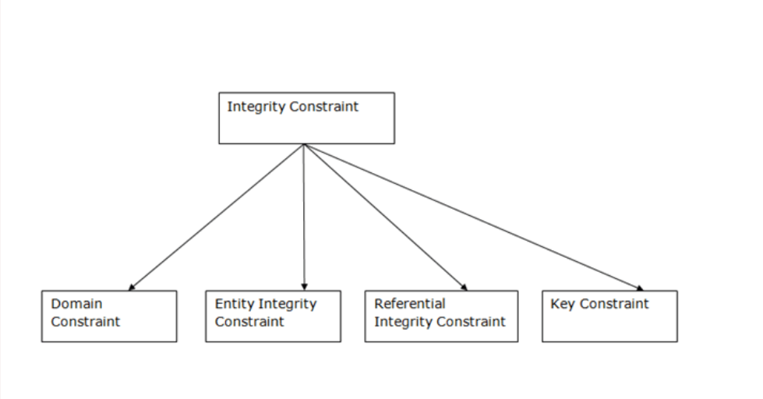
Recap

Slide 4
Objectives
By the end of this lesson, students should be able to :
Describe SQL
Categorise SQL commands
Define database structures

Slide 5
Structured Query Language (SQL)
Is used to perform operations on the records stored in the database such as updating records, deleting records, creating and modifying tables, views, etc.
SQL is a database language, it is used for database creation, deletion, fetching rows, and modifying rows, etc
It is pronounced as S-Q-L
SQL is just a query language; it is not a database.
SQL is not a programming language

Slide 6
Structured Query Language (SQL)
Data Definition Language- DDL
Data Manipulation Language - DML
Data Query Language- DQL
Data Control Language - DCL
Data administration commands
Transaction control commands
Concurrency controls

Slide 7
Structured Query Language (SQL)
SQL follows some unique set of rules and guidelines called syntax.
SQL is not case sensitive. Generally, SQL keywords are written in uppercase.
We can place a single SQL statement on one or multiple text lines.
You can perform most of the action in a database with SQL statements.
SQL statements are started with any of the SQL commands/keywords like SELECT, INSERT, UPDATE, DELETE, ALTER, DROP etc. and the statement ends with a semicolon (;).

Slide 8
Naming Convention
Naming conventions determine the style in which you name objects in your database.
It is advisable to follow a standard naming convention
Always remember
  Don’t start any object name with a number.
  Don’t use spaces when naming objects.
  Don’t use keywords to name your objects such as TABLE, or INDEX.
Adopt one naming convention throughout, and be consistent with it.

Slide 9
Data Definition Language (DDL)
Used to define database structures
definition statements include:
  CREATE
        To create database objects
  ALTER
        To modify the structure and/or characteristics of database objects
  DROP
        To delete database objects
  TRUNCATE- To delete table data while keeping structure
Can be used on database object like tables, views, indexes

Slide 10
Data Definition Language (DDL)
Create a database
CREATE database databaseName;
Example
CREATE database Uni;
Creates a database named Uni

Slide 11
Data Definition Language (DDL)
Create table
CREATE TABLE TableName
( AttributeName Domain [ Constraint ] ........
AttributeName Domain [ Constraint ] [ OtherConstraints ] );

Slide 12
Data Definition Language (DDL)
Create Table
CREATE TABLE tablename (
Attributename1 datatype, attributename2 datatype constraint, attributenamen datatype );
Example
  CREATE TABLE Student(
  studno int PRIMARY KEY,
  GivenName varchar(25),
  FamilyName varchar(50),
  gender char(1) );

Slide 13
Data Definition Language (DDL)
  CREATE TABLE Student
( Student_id int NOT NULL,
Given_name VARCHAR(20),
Course_id int,
PRIMARY KEY (Student_id),
FOREIGN KEY (Course_id) REFERENCES Course (course_id));

Slide 14
Data Definition Language (DDL)
ALTER TABLE
The ALTER TABLE statement is used to add, modify or delete columns in an existing table.
It is also used to rename a table.
You can also use SQL ALTER TABLE command to add and drop various constraints on an existing table.

Slide 15
Data Definition Language (DDL)
ALTER TABLE to Add Column use:
ALTER TABLE table_name ADD column_name column-definition;
example
ALTER TABLE Student ADD Age int NOT NULL;
Adds a column age to the Student Table we created earlier;

Slide 16
Data Definition Language (DDL)
To modify a column
ALTER TABLE table_name MODIFY column_name column_type;
Write a statement to modify age column in Student so that it takes char values

Slide 17
Data Definition Language (DDL)
Rename column in a table
ALTER TABLE table_name
RENAME COLUMN old_name to new_name;
Example
Alter Table Student Rename column GivenName to first_name;
Renames column GivenName in table Student to first_name;

Slide 18
Data Definition Language (DDL)
To drop a column
ALTER TABLE table_name DROP COLUMN column_name;
Example
Alter Table Student drop column Age;
The statement deletes the column Age from the Table Student.

Slide 19
Data Definition Language (DDL)
SQL DROP statement is used to delete or remove indexes from a table in the database.
DROP DATABASE database_name;
Example
DROP DATABASE Uni;
NB: if you delete or drop the database, all the tables and views will also be deleted.

Slide 20
Data Definition Language (DDL)
A SQL DROP TABLE statement is used to delete a table definition and all data from a table.
This is very important to know that once a table is deleted all the information available in the table is lost forever
DROP TABLE table_name;
example
DROP TABLE Student;
Will delete table Student from the database and all data in it.

Slide 21
Data Definition language
A truncate SQL statement is used to remove all rows from a table.
TRUNCATE TABLE table_name;
Example
What will this statement do?
Truncate Table Student;

Slide 22
Practicals
Review how to access Microsoft SQL Server Management Studio in Lab 1 and the guide provided on course resources.
Complete Lab 7
Given the physical schema, write SQL statements to implement the defined database on Microsoft SQL Server Management Studio.

Slide 23
Summary
We will learn about more database objects as we progress with SQL
All objects are defined using the CREATE statement
change an already existing table structure using ALTER statement
Delete existing objects and their contents using DROP statement
Delete the contents of a database table using TRUNCATE
Note: the difference between DROP and TRUNCATE statements.

Slide 24
Next Lecture
In the next lecture, we will discuss
Data Manipulation Language (DML)

Slide 25
References
David M. Kroenke And David J. Auer (2013) Database Concepts, 6th Edition.
Java Point SQL Tutorial [online] available at https://www.javatpoint.com/sql-tutorial

